Slide 1

2nd Project Proposal
PRESENTED BY:
Rahul kumar Mahato
Masters in Data science & Applied statistics
EnRoll No - CUSB2302222005
SEMESTER - III
[SESSION: 2023-2025]
𝕯𝖊𝖕𝖆𝖗𝖙𝖒𝖊𝖓𝖙 𝖔𝖋 𝕾𝖙𝖆𝖙𝖎𝖘𝖙𝖎𝖈𝖘
SCHOOL OF MATHEMATICS, STATISTICS AND COMPUTER SCIENCE
Central University of South Bihar , Gaya

Slide 2
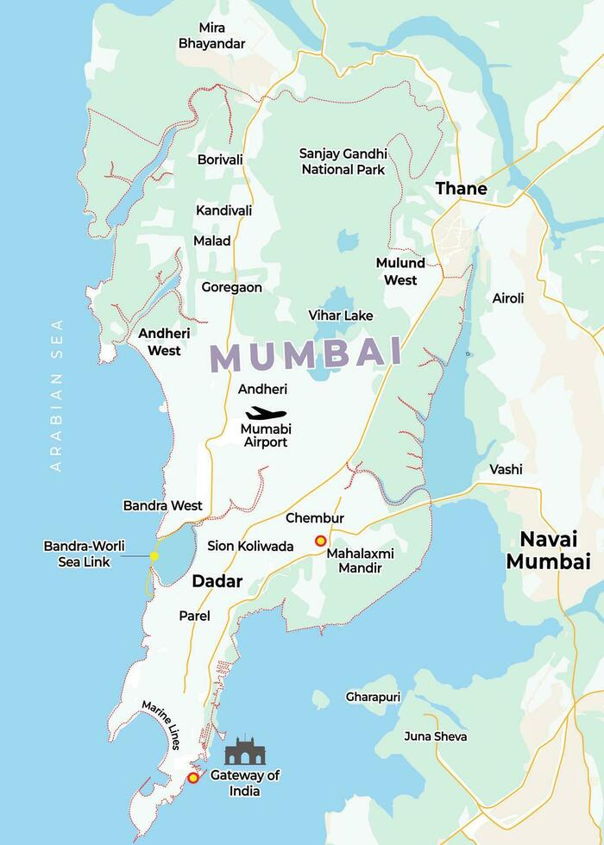
Prediction of Air Quality Index for Mumbai Region: A Machine Learning Approach
Project Title:

Slide 3
Objective
.
Mumbai faces ongoing air pollution challenges due to rapid urbanization, dense population, and industrial activity. The primary objective of this project is to analyze and predict the Air Quality Index (AQI) in Mumbai using machine learning algorithms and artificial neural networks (ANN).
.
Iterative approaches to corporate strategy
Establish a management framework from the inside
By identifying patterns in pollutant concentrations and weather data, this project aims to forecast Air Quality Index levels accurately and provide insights into reducing pollution in the city. This model will serve as a tool to inform policy decisions, enhance pollution control measures, and improve public health in Mumbai.

Slide 4
Introduction
1.1 Mumbai Air Pollution
Mumbai, spanning an area of 603.4 km², is located on the western coast of India, along the Arabian Sea, with a latitude range from 18.887 to 19.271°N and a longitude range from 72.775 to 72.978°E. Governed by the Maharashtra state government and the Brihanmumbai Municipal Corporation (BMC), Mumbai is the financial capital of India and one of the most densely populated cities globally. As of the 2011 census, it is home to approximately 12.4 million residents, making it the most populous city in India. This dense population, along with rapid urban and economic development, has led to significant air quality challenges in the city.
What’s Polluting Mumbai’s Air?
Air pollution has become an escalating issue in Mumbai, as both urban and industrial activities have continued to grow rapidly. Mumbai's air pollution is a serious health and environmental concern, affecting millions daily. The major contributors to Mumbai's deteriorating air quality include vehicular emissions, industrial activities, construction dust, and seasonal changes that often exacerbate pollution levels. Although the city has taken various measures to control pollution, particularly in recent years, the challenge remains formidable due to continuous population growth and economic expansion.
Mumbai’s air quality has increasingly been monitored and studied to assess pollution levels accurately. Yet, common questions such as the exact levels of pollution and identifying specific pollution sources remain. This project seeks to analyze and forecast Mumbai’s Air Quality Index (AQI), leveraging pollutant concentration data and meteorological variables, to better understand the patterns and potential interventions for improving air quality in the city.

Slide 5
This study aims to contribute to the existing body of research by using machine learning techniques on historical data to provide predictive insights on Mumbai’s AQI. By identifying significant pollutant contributors and environmental patterns, this project will aid policymakers and environmental agencies in formulating targeted pollution control measures for Mumbai.
In the dataset for predicting the Air Quality Index (AQI) of Mumbai, the key pollutants that are important for understanding air quality and influencing AQI levels include the following:
1. PM2.5 (µg/m³)
Particulate Matter (PM2.5) refers to fine particles with a diameter of 2.5 micrometers or smaller. Due to their small size, these particles can penetrate deep into the lungs and enter the bloodstream, posing significant health risks.
Sources: PM2.5 is primarily emitted from vehicle exhaust, industrial emissions, combustion of fossil fuels, construction activities, and biomass burning. It is particularly hazardous and a major contributor to smog.
Health Effects: Prolonged exposure to PM2.5 can cause respiratory issues, cardiovascular diseases, and worsen conditions like asthma and bronchitis.
2. PM10 (µg/m³)
Particulate Matter (PM10) refers to larger particles with a diameter of 10 micrometers or smaller. These particles can settle in the respiratory tract but are less likely to penetrate deeply compared to PM2.5.
Sources: PM10 is generated from construction dust, road dust, industrial emissions, and agriculture. It also includes pollen, mold spores, and other airborne particles.
Health Effects: Exposure to PM10 can cause irritation of the eyes, nose, and throat, respiratory problems, and aggravate existing health conditions like asthma.

Slide 6
3. NO (Nitric Oxide) (µg/m³)
Nitric Oxide (NO) is a reactive gas primarily emitted from vehicle engines and industrial processes during combustion at high temperatures.
Sources: The primary sources of NO are combustion engines in vehicles, power plants, and industrial facilities.
Health Effects: While less harmful on its own, NO can react with other chemicals in the atmosphere to form nitrogen dioxide (NO₂) and contribute to the formation of ground-level ozone, both of which can cause respiratory problems.
4. NO₂ (Nitrogen Dioxide) (µg/m³)
Nitrogen Dioxide (NO₂) is a toxic gas that contributes to the formation of smog and acid rain. It is a significant air pollutant and a major contributor to poor air quality.
Sources: NO₂ is formed when fuel is burned at high temperatures, particularly in motor vehicles, power plants, and factories.
Health Effects: Prolonged exposure to NO₂ can cause respiratory problems, lung inflammation, decreased lung function, and increased risk of respiratory infections.
5. NOx (ppb)
Nitrogen Oxides (NOx) is a term that represents a group of gases including NO and NO₂. These gases play a key role in forming ground-level ozone and particulate matter.
Sources: Similar to NO and NO₂, NOx is mainly emitted from vehicles, power plants, and industrial activities.
Health Effects: Exposure to high levels of NOx can increase the likelihood of developing asthma, bronchitis, and other respiratory conditions.

Slide 7
6. NH₃ (Ammonia) (µg/m³)
Ammonia (NH₃) is a colorless gas with a distinct odor, often released from agricultural activities, fertilizers, and industrial processes.
Sources: The primary sources of NH₃ include agriculture (particularly livestock waste and fertilizers), sewage treatment plants, and vehicle emissions.
Health Effects: Ammonia can irritate the eyes, nose, and throat. In higher concentrations, it can lead to respiratory problems and contribute to the formation of fine particulate matter (PM2.5).
7. SO₂ (Sulfur Dioxide) (µg/m³)
Sulfur Dioxide (SO₂) is a gas that is released when sulfur-containing fuels like coal, oil, or diesel are burned.
Sources: Major sources include power plants, industrial processes (especially metal smelting), and vehicle emissions. Volcanoes also naturally release SO₂ into the atmosphere.
Health Effects: Exposure to SO₂ can cause respiratory symptoms, aggravate asthma, and contribute to the formation of fine particulate matter and acid rain.
8. CO (Carbon Monoxide) (mg/m³)
Carbon Monoxide (CO) is a colorless, odorless gas produced by incomplete combustion of carbon-based fuels.
Sources: The primary sources of CO are motor vehicle exhaust, industrial emissions, and burning of biomass (e.g., wood, coal).
Health Effects: High levels of CO can lead to dizziness, confusion, and even death due to the gas’s ability to prevent oxygen from being transported in the blood.

Slide 8
O₃ (Ozone) (µg/m³)
Ozone (O₃) at ground level is a secondary pollutant formed by the reaction of sunlight with nitrogen oxides (NOx) and volatile organic compounds (VOCs). While ozone high in the atmosphere protects us from the sun’s UV rays, ground-level ozone is harmful.
Sources: O₃ is formed through chemical reactions between NOx and VOCs, often emitted from vehicles, power plants, and industrial sources.
Health Effects: Ground-level ozone is a major component of smog and can cause a range of respiratory issues, including chest pain, coughing, and throat irritation. It can also worsen conditions like asthma and bronchitis.

Slide 9
Air Quality Index (AQI) Awareness of daily levels of air pollution is important to the citizens, especially for those who suffer from illnesses caused by exposure to air pollution. Further, success of a nation to improve air quality depends on the support of its citizens who are well-informed about local and national air pollution problems and about the progress of mitigation efforts. Thus, a simple yet effective communication of air quality is important. The concept of an air quality index (AQI) that transforms weighted values of individual air pollution related parameters (e.g. SO2, CO, visibility, etc.) into a single number or set of numbers is widely used for air quality communication and decision making in many countries. Air quality monitoring procedures and protocols, Indian National Air Quality Standards (INAQS) and dose-response relationships of pollutants, an AQI system is devised. The AQI system is based on maximum operator of a function (i.e. selecting the maximum of subindices of individual pollutants as an overall AQI). The objective of an AQI is to quickly disseminate air quality information (almost in real-time) that entails the system to account for pollutants which have short-term impacts. Eight parameters (PM10, PM25, NO2, SO2, CO, O3, NH3, and Pb) having short-term standards have been considered for near real-time dissemination of AQI. It is recognized that air concentrations of Pb are not known in real-time and cannot contribute to AQI. However, its consideration in AQI calculation of past days will help in scrutinizing the status of this important toxic. The proposed index has six categories with elegant colour scheme, as shown below

Slide 10
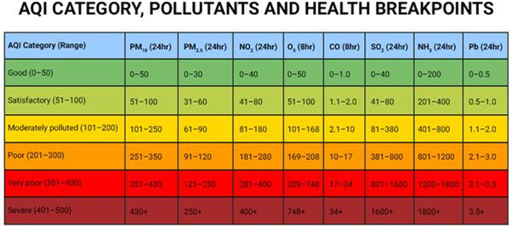
Indian Air Quality Index system Air quality standards are the basic foundation that provides a legal framework for air pollution control. An air quality standard is a description of a level of air quality that is adopted by a regulatory authority as enforceable. The basis of development of stan dards is to provide a rational for protecting public health from adverse effects of air pollutants, to eliminate or reduce exposure to hazardous air pollutants, and to guide national/ local authorities for pollution control decisions. With these objectives, CPCB notified (http://www.cpcb.nic.in) a new set of Indian National Air Quality Standards (INAQS) for 12 parameters [carbon monoxide (CO) nitrogen dioxide (NO2), sulphur dioxide (SO2), particulate matter (PM) of less than 2.5microns size (PM25), PM of less than 10 microns size (PM10), Ozone (O3), Lead (Pb), Ammonia (NH3),Benzo(a)Pyrene (BaP), Benzene (C6H6), Arsenic (As), and Nickel (Ni)] . The first eight parameters have short-term (1/8/24 hrs) and annual standards (except for CO and O3) and rest four pa rameters have only annual standards

Slide 11
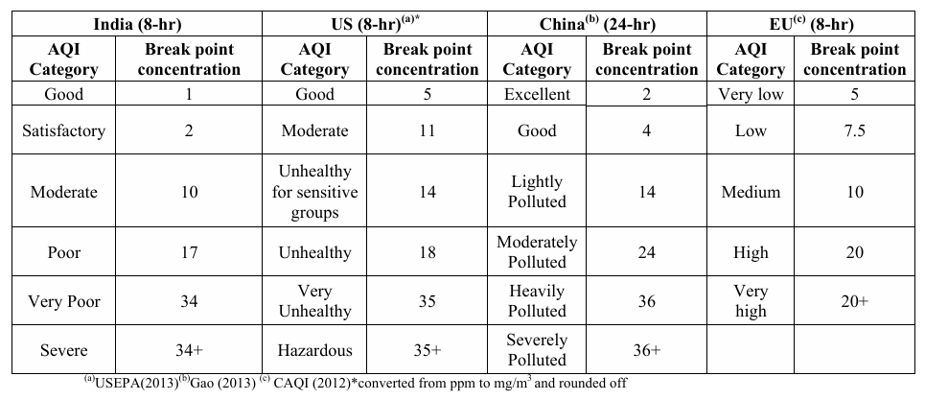
Computation and Basis of Sub-index Breakpoints
Carbon Mono-oxide (CO)

Slide 12
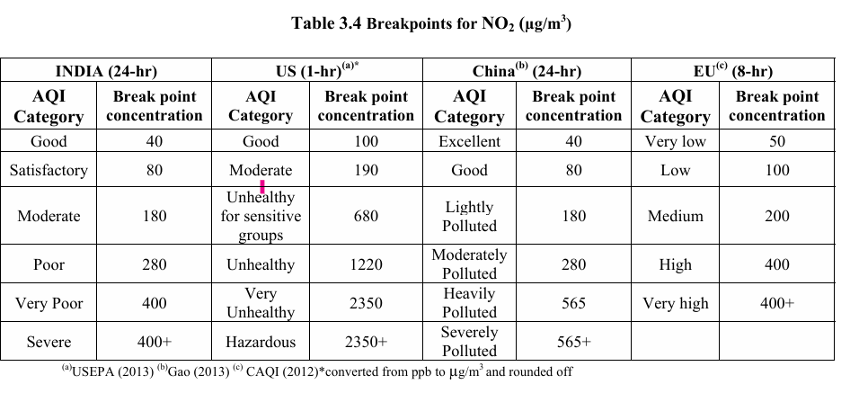
Nitrogen Dioxide (NO2)

Slide 13
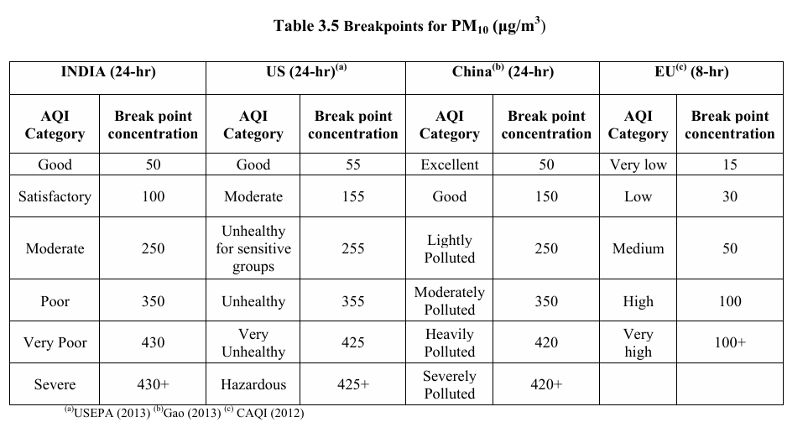
Particulate Matter (PM):PM10 and PM2.5

Slide 14
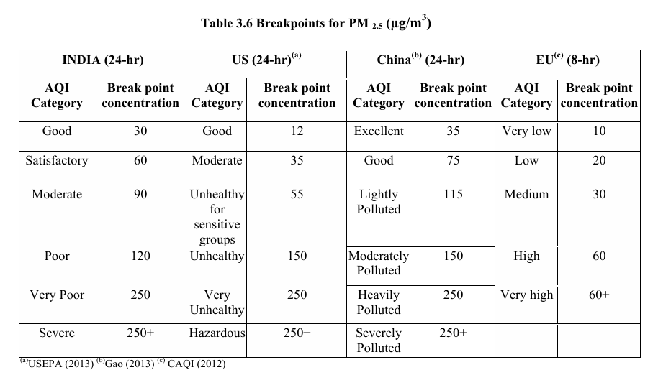

Slide 15
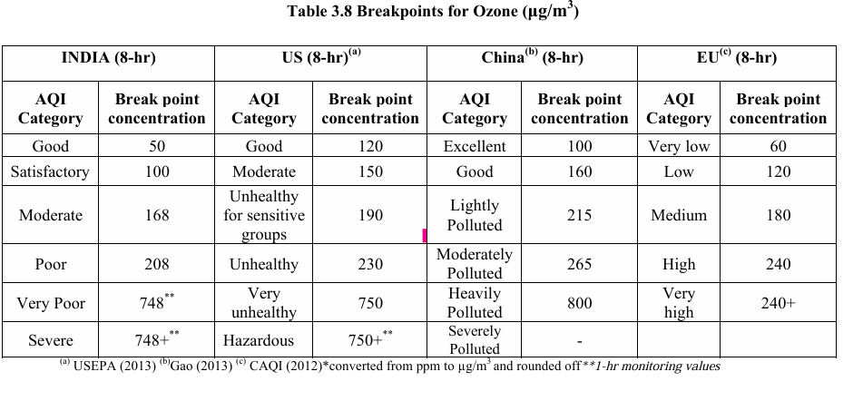
Ozone

Slide 16
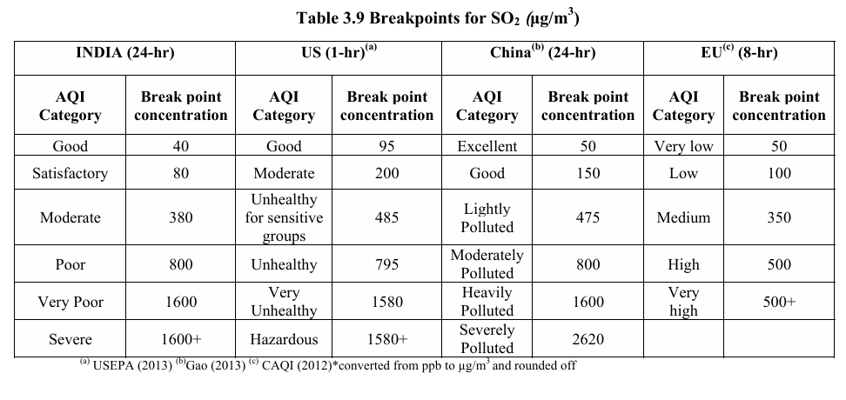
Sulphur Dioxide (SO2)

Slide 17
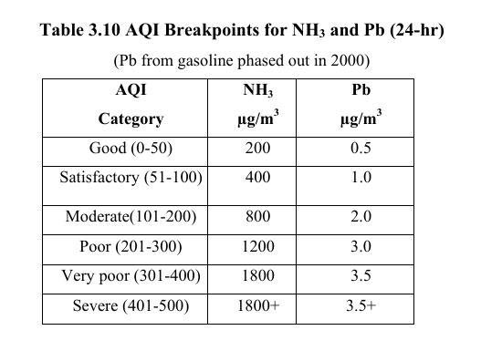
Pb and NH3

Slide 18
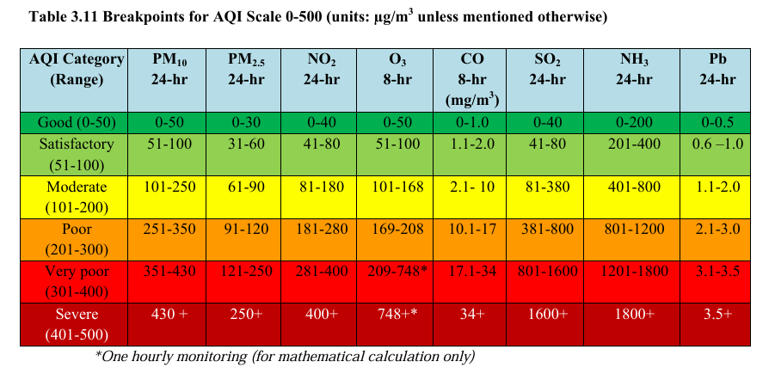
CPCB may consider reviewing the AQI breakpoints every three years after accounting the new research findings on air pollution exposure and health effects.

Slide 19
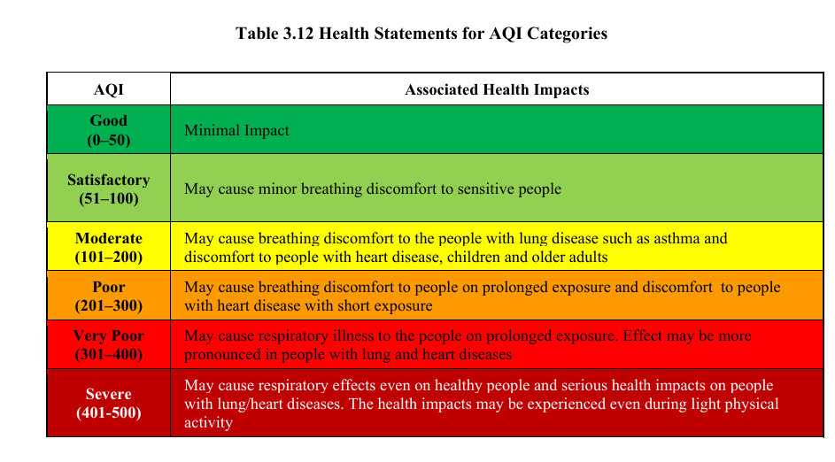

Slide 20
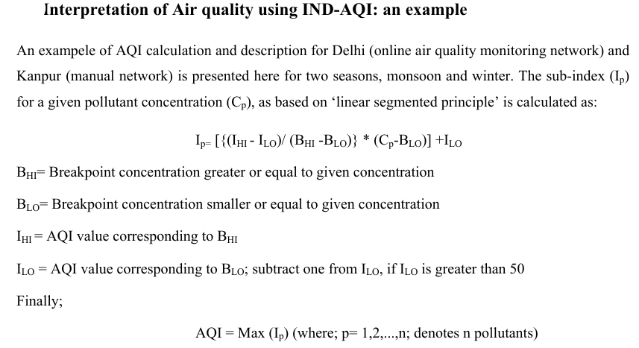

Slide 21






Data preprocessing steps:
Data Cleaning
Remove or fill in missing or inconsistent data points to ensure the dataset is complete and ready for analysis.
Feature Selection
Normalization
Identify the most important variables (e.g., pollutants like PM2.5, PM10, and weather conditions) that contribute to AQI prediction, and remove less relevant features.
Scale the data so that all features have comparable ranges, improving the performance of machine learning algorithms.
Handling Outliers
Train-Test Split
Detect and address extreme values (outliers) that could distort the model’s learning process.
Divide the dataset into training and testing sets to evaluate the model’s performance on unseen data.
Data Transformation
Apply techniques like encoding categorical variables or creating new features from existing ones to enhance the dataset's usability and relevance for the model.

Slide 24
Thank you..

